Slide 1
Welcome to P1 !
Wednesday 2nd June 2021
6.30 pm

Slide 2
Growing Up Project – Mon 7th to Fri 10th June
Chn in our EYC will meet P1 staff during the day. Chn not in our EYC have been issued appointments after school. All visits will take place outdoors to comply with Covid 19 guidance. You will also receive forms during this week which you should complete and hand in to the school.
Virtual tour and transition booklet
Our virtual tour shows the P1 playground and classrooms and has messages from key members of staff. We will also send you a booklet with photographs on it to share with your child over the summer period.

Slide 3

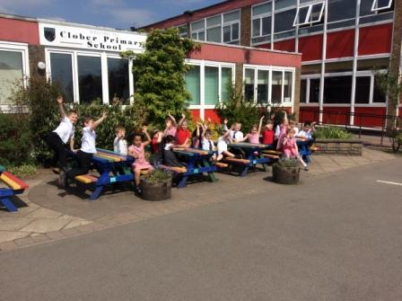
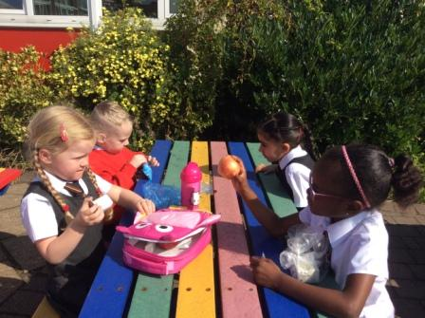
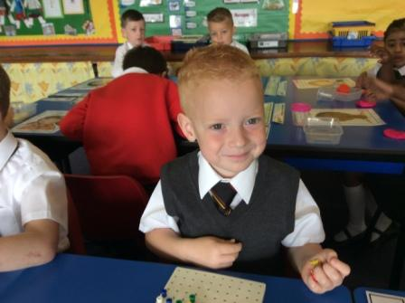
First Day Thurs 12th August

Slide 4
What to bring ….
A filled water bottle
Healthy snacks (fruit is best, two pieces is enough)
A packed lunch if you do not want your child to have a school lunch (remember these are free for P1).
A waterproof jacket
We will provide all other materials. Each child will receive a pack of things they will need. Please do not bring in items from home such as toys or comforters due to Covid 19 guidance.
PE – children come to school wearing their PE clothes. Shorts/leggings/joggers, t-shirt and suitable footwear. We will let you know your child’s PE days in August.
Please label all belongings with your child’s name so if lost they can be easily returned.

Slide 5
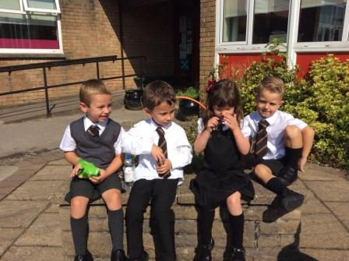
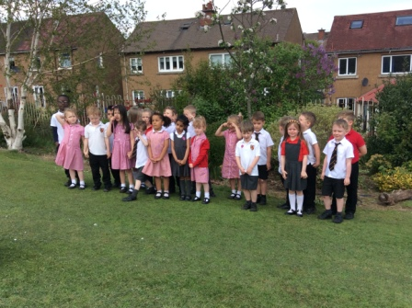
What to wear ….
www.schoolwearmadeeasy.com

Slide 6


Playtime
We have adults in the playground to supervise the children. All classes are kept separate in zones at the moment due to Covid guidance. There is an adult in each zone. They carry first aid equipment.
Our adults are instantly recognisable
as they wear fluorescent vests.
This ensures we keep our children
safe.
We play outside in all weather so please ensure your child has a waterproof jacket and suitable footwear.

Slide 7

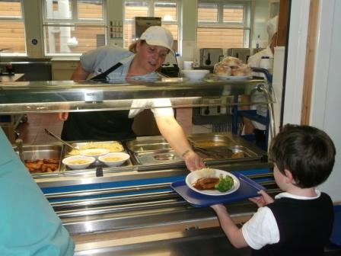
Lunch
The children go to the dining hall to eat their lunch. There is a space for each class. Our support staff help them and a member of SLT is always there to supervise.
Children are asked to order their meals when they come in the morning. We keep a record of what they have asked for. If your child does not want a school meal they can bring a packed lunch.

Slide 8
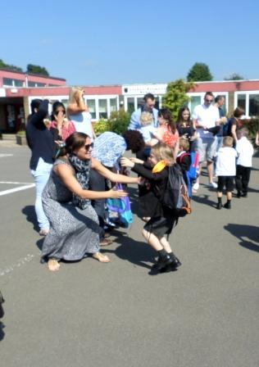

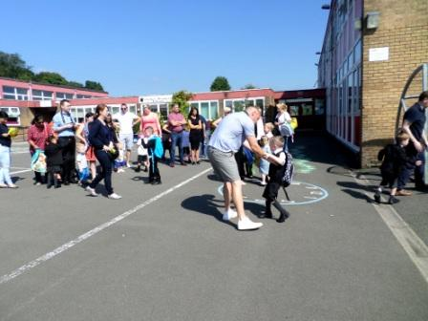
Home time

Slide 9
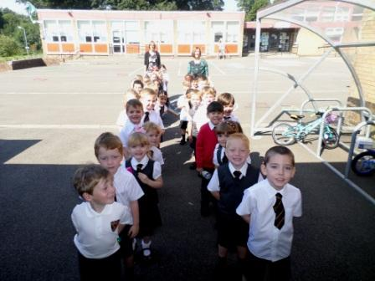
Day 2 and beyond ….
After the first day, your child should arrive at the usual time of 9.00 a.m. and line up at the P1 door. To encourage independence it is good if your child can come into the playground themselves – a member of SLT will be there.
Children can be collected at 3pm from the school gate. Staff will ensure each child is matched to the adult taking them home.

Slide 10



The school year
Permission forms
Assemblies
Church services
Concerts/nativity
School clubs
Charity fundraisers
School discos
Film nights
Ceilidh
Christmas and Summer Fayres

Slide 11
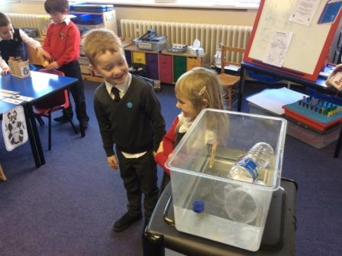
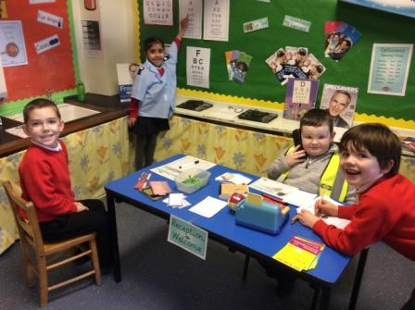
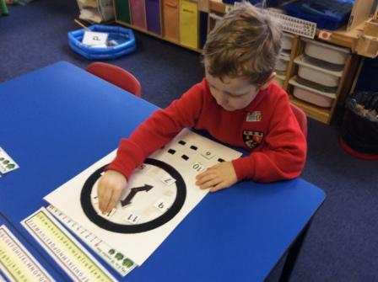
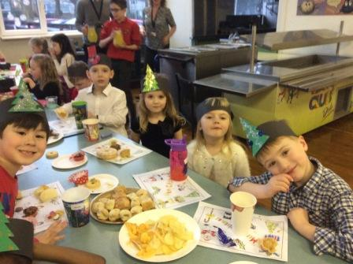
Our Values
Aspire
Respect
Achieve
Enjoy

Slide 12

Curriculum for Excellence
Literacy, Numeracy, Health and Wellbeing
Social Studies, Expressive Arts, RME, Sciences and Technologies
Early – first – second levels
Successful learners, confident individuals, responsible citizens and effective contributors

Slide 13
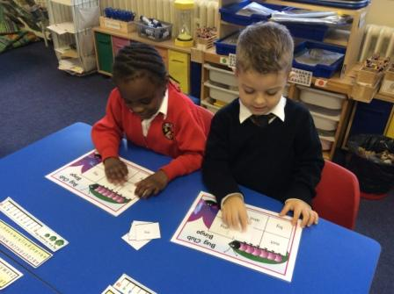
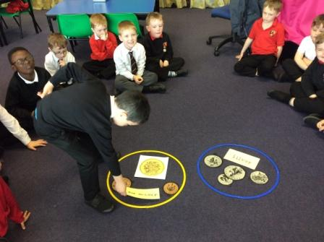
Assessing progress
Nursery transition data and Getting to Know You
Based on teacher’s day to day teaching and professional judgement
Self and peer assessment
Evidence – what pupils say, write, make, do
Formal assessment - Baseline, SNSA

Slide 14
Support for learning
We all need support sometimes. Early intervention makes all the difference.
Class teacher
Mrs Christine Furnish, Support for Learning
Mrs Cara Greer, Principal Teacher
DHT Mrs Jennifer Law has responsibility for Support for Learning
Parents will be informed and involved in the review of progress.
Working with specialists such as Speech and Language, Educational Psychologist, Occupational Therapy

Slide 15
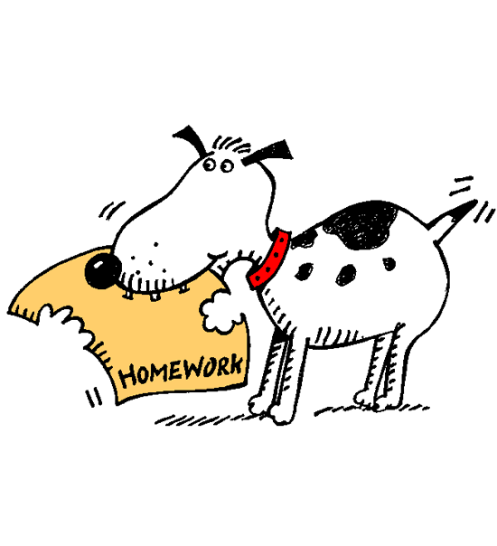
Homework
Homework will usually involve reading, a number activity and sometimes activities related to social subjects.
Our reading is online – please let us know if you do not have internet access (there’s a letter in the pack).
Remember to spend lots of time in the fresh air, at the library and enjoying free time too!

Slide 16

Get Involved ….
Meet the teacher
Open afternoons
Parent/Teacher meetings twice a year
Newsletters
Curricular meetings throughout the year
Parent Council
Complaints procedure

Slide 17
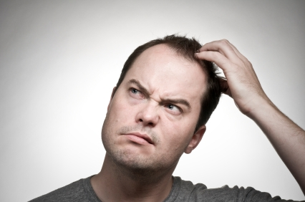
What do I do if….?
My child is off or will be late?
Email or phone the office as soon as possible. We check attendance every morning and afternoon.
My child is well enough to attend school but needs medicine in school hours?
You must complete a form before we can administer medicine. Contact the office and they will be able to help you.
I need to change arrangements for collection at the end of the day?
Phone or email the office. We will never let your child go with someone unexpected unless you let us know.

Slide 18

Mon 7th – Fri 11th June Growing Up Project
Thurs 12th August First Day

