Slide 1
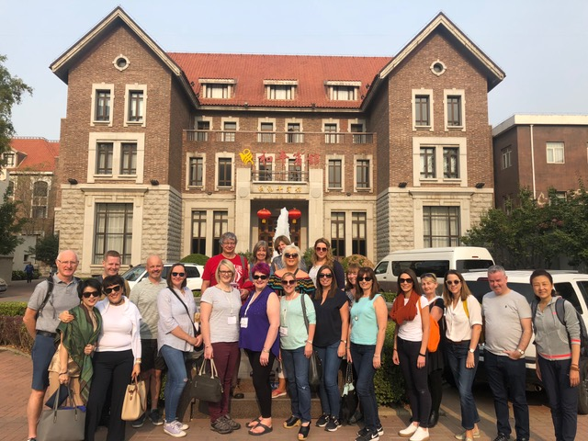
China 2018

Slide 2
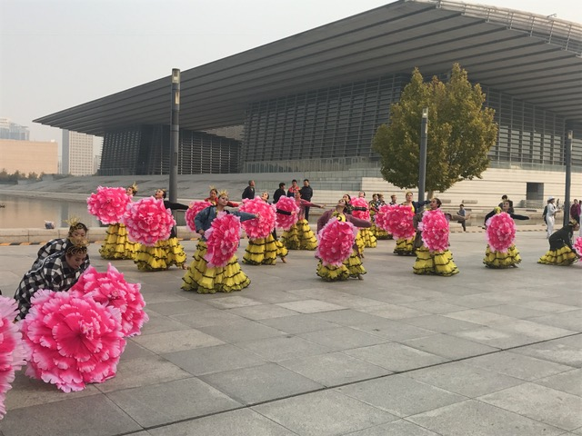
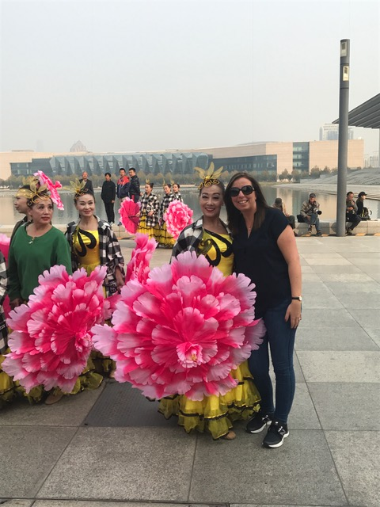
Tianjin Cultural Center At the Center there was a dance festival. Obviously Mrs Law had to get involved! Chinese TV were there and announced that Head Teachers were over from Scotland. Everyone was desperate to get their photo taken with us!

Slide 3
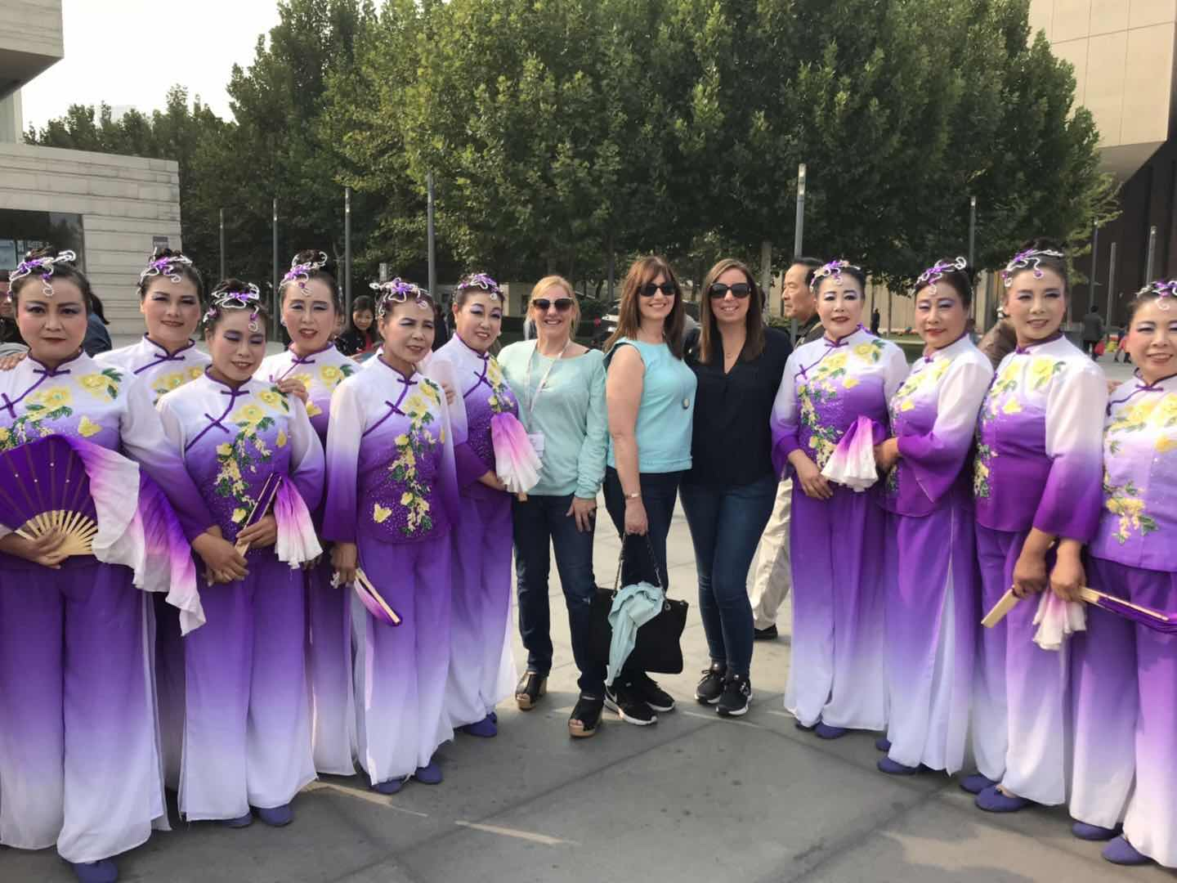
Look at their costumes. They are very bright and colourful!

Slide 4
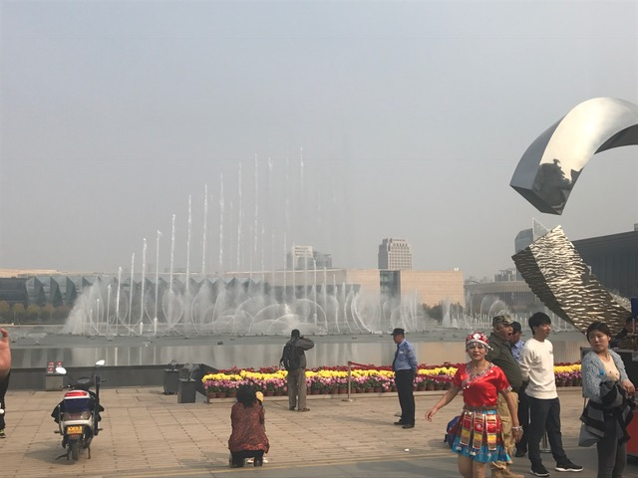
The beautiful fountains at the Cultural Center

Slide 5
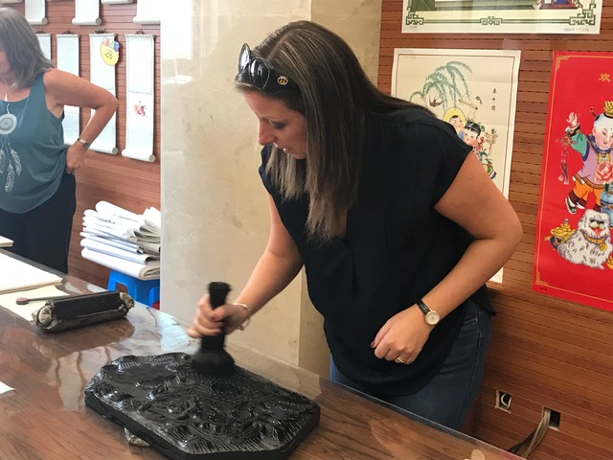
Woodblock Painting at the Museum
Step 1
Put the ink on the special brush then swirl the brush around the block.

Slide 6
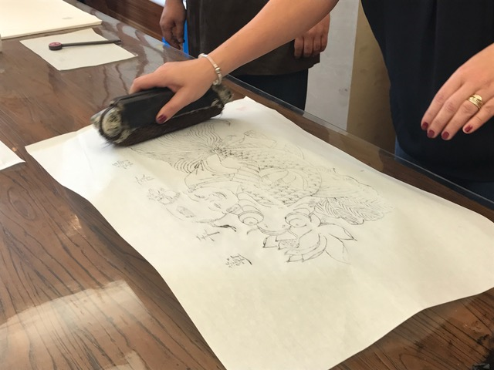
Step 2 Place your paper over the block and carefully rub the ink onto the paper.

Slide 7
Step 3 Peel back your paper to produce a lovely block painting!

Slide 8
Tianjin Food Street

Slide 9
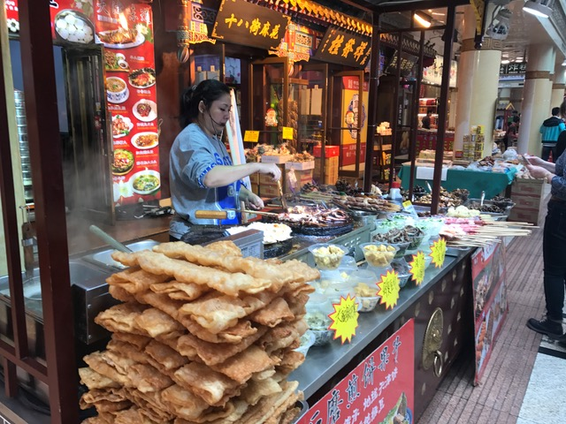
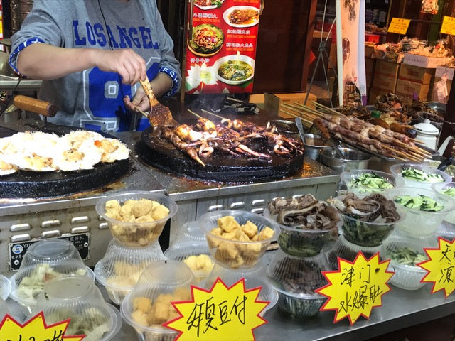
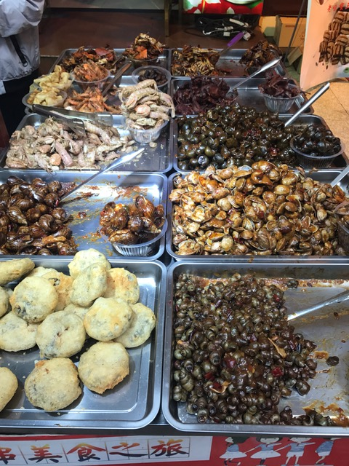
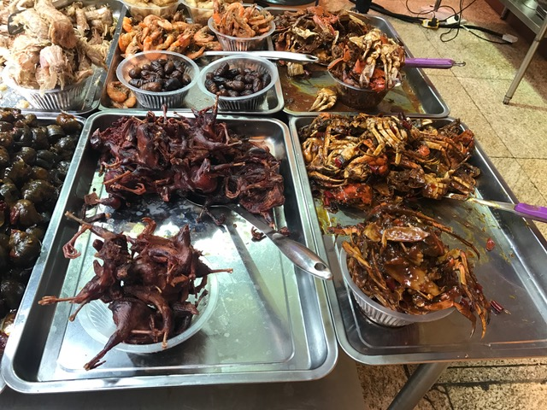
The food in China is very different from the food in Scotland!

Slide 10
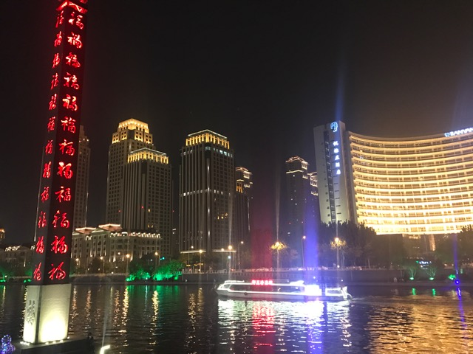
Beautiful Night Scene on the Haihe River

Slide 11
Mrs Law visits Yue Yang Dao Xiao Xue Primary School. Their school values were: To make school a kind of enjoyment To make study a kind of joy. To make development a kind of happiness

Slide 12
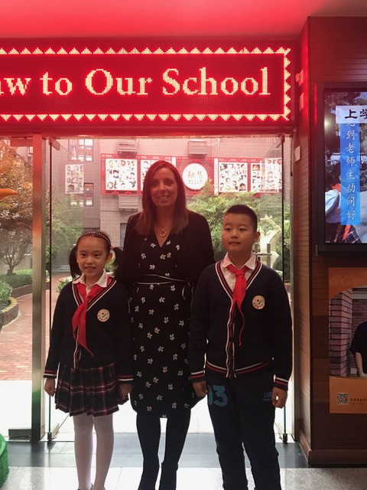
https://m.youtube.com/watch?v=_jEkodMsC9U

Slide 13
The school had a beautiful garden outside. On the wall they had lots of photos of children smiling. They called it the ‘wall of smiles’. When children feel sad at school they take them here to cheer them up!

Slide 14
Here are some examples of how they take their class photo.

Slide 15
Within the school they also had a museum to display their achievements and anything that they were proud of.

Slide 16
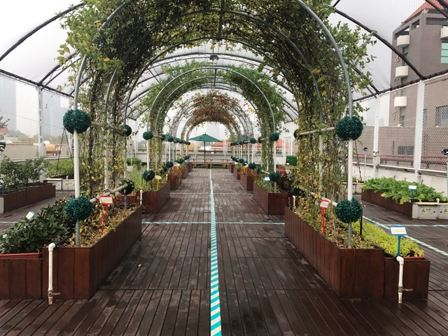
As the school is in the centre of Tianjin they do not have much outdoor space. This garden was on the roof of the school. It used to be a tennis court!!

Slide 17
Here are some examples of children's work. They take great pride in their presentation.

Slide 18
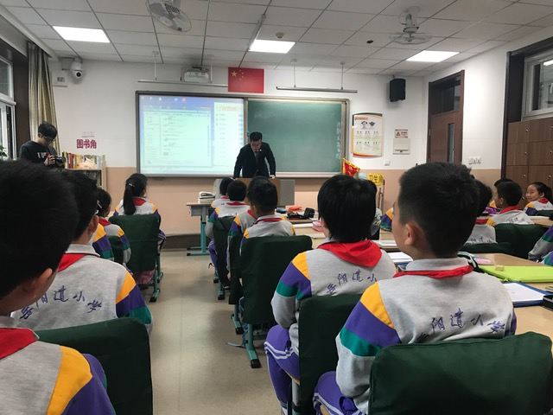
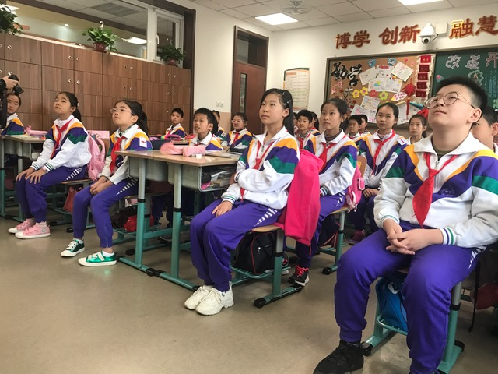
https://youtu.be/CYiR304qEJg
https://youtu.be/OYdPwwJtyXc

Slide 19
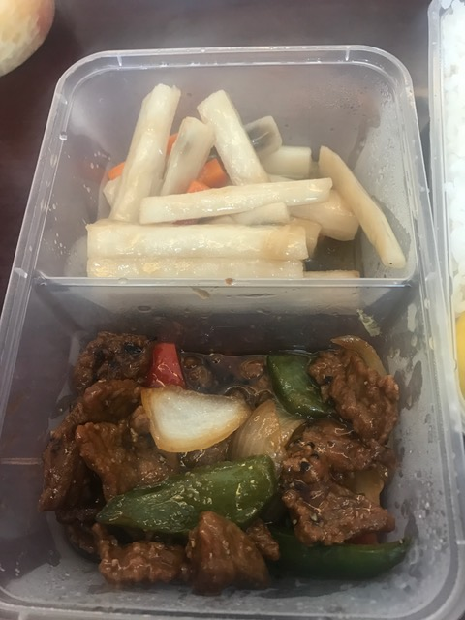
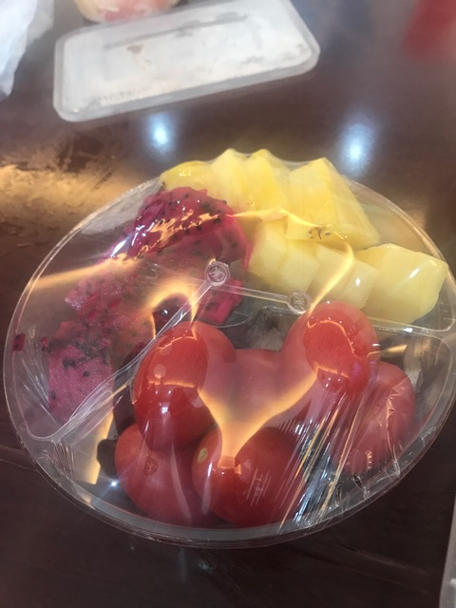
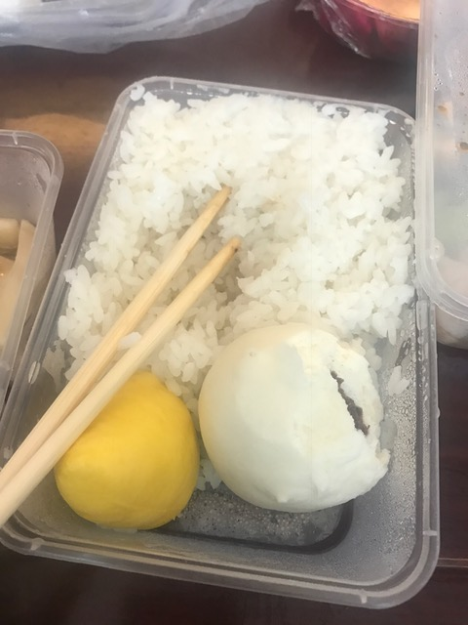
Lunchtime!

Slide 20
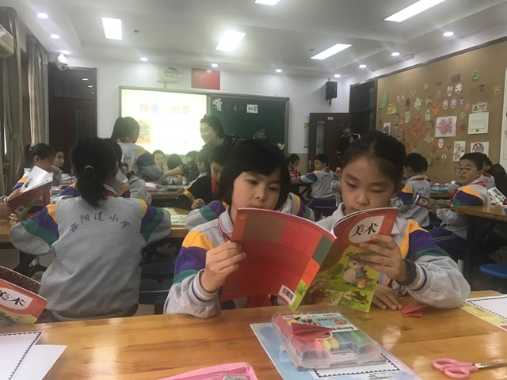
https://m.youtube.com/watch?v=CH-0Kvdvs1I

Slide 21
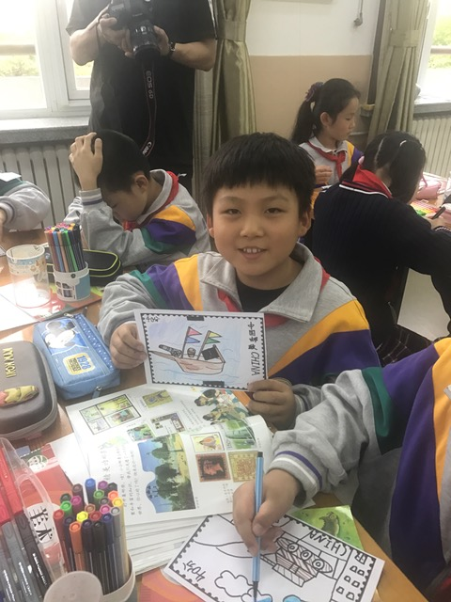
Art Lesson

Slide 22
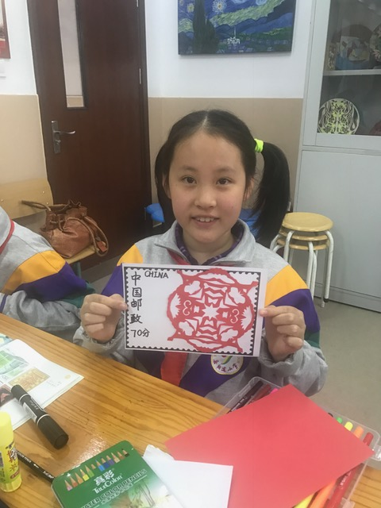
Paper Cutting
https://youtu.be/imqXLai5QDc

Slide 23
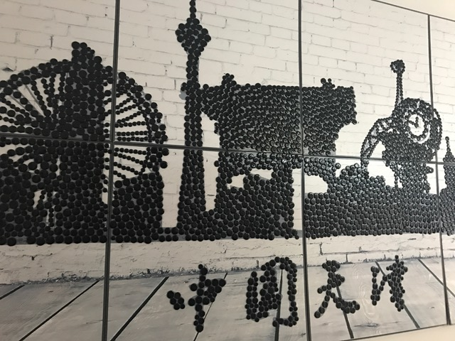

Slide 24
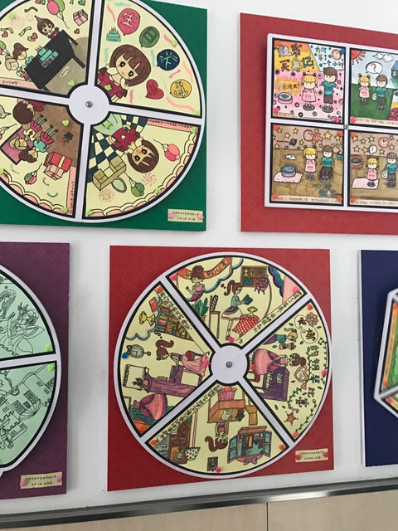
https://mp.weixin.qq.com/s/QP9patenHox2QBFjXkeATg

Slide 25
Hanban Institute

Slide 26
Beijing The Watertown and The Great Wall

Slide 27
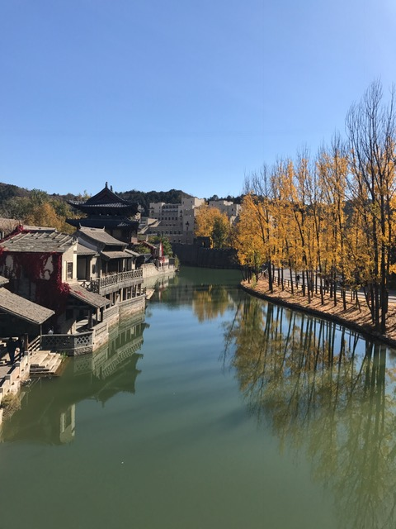
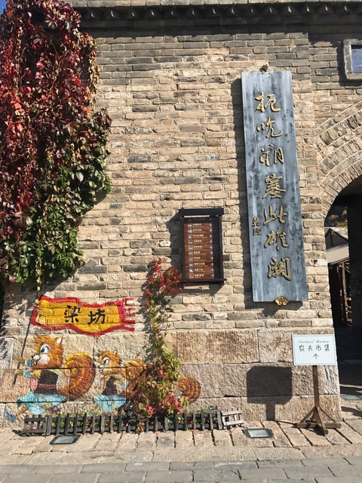
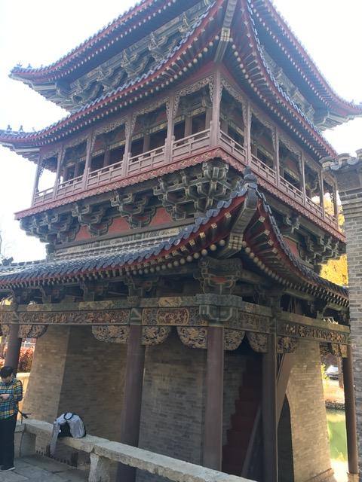
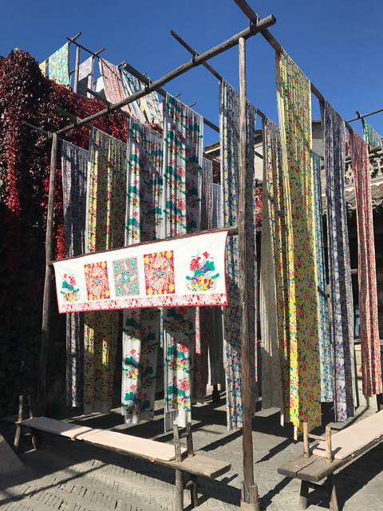

Slide 30
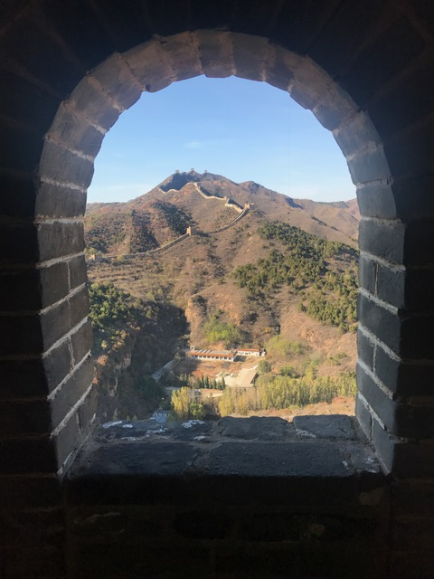

Slide 31
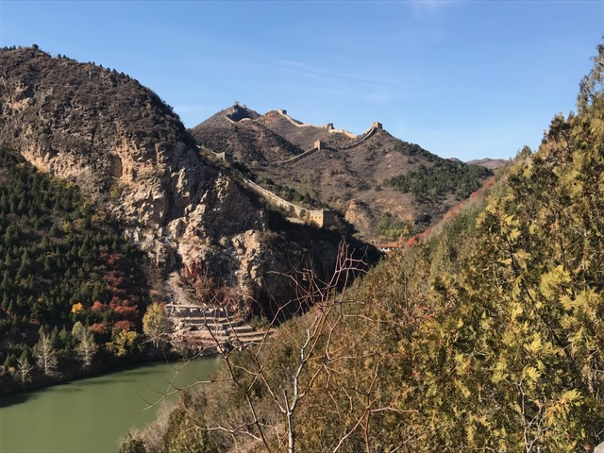

Slide 32
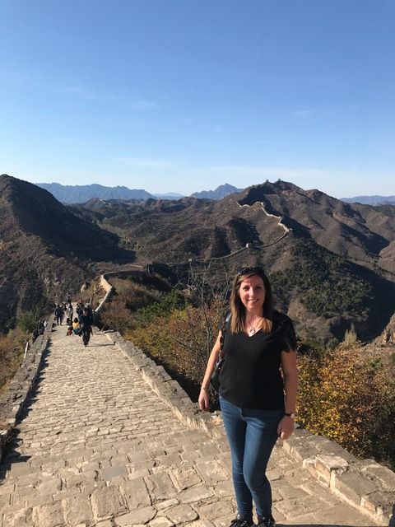

Slide 34
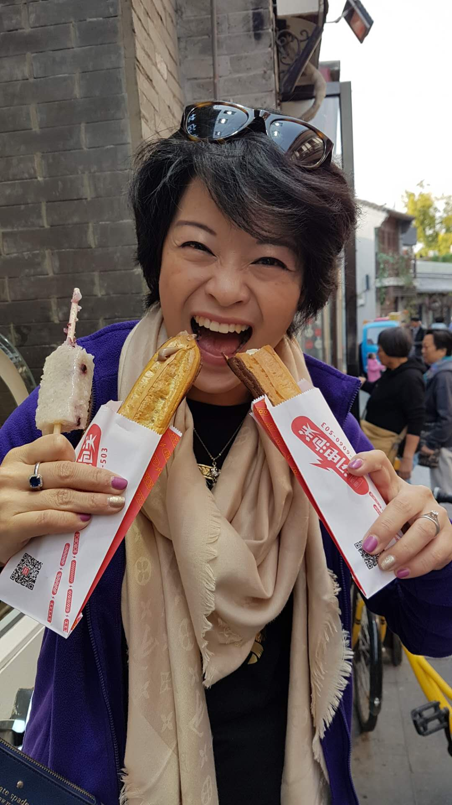
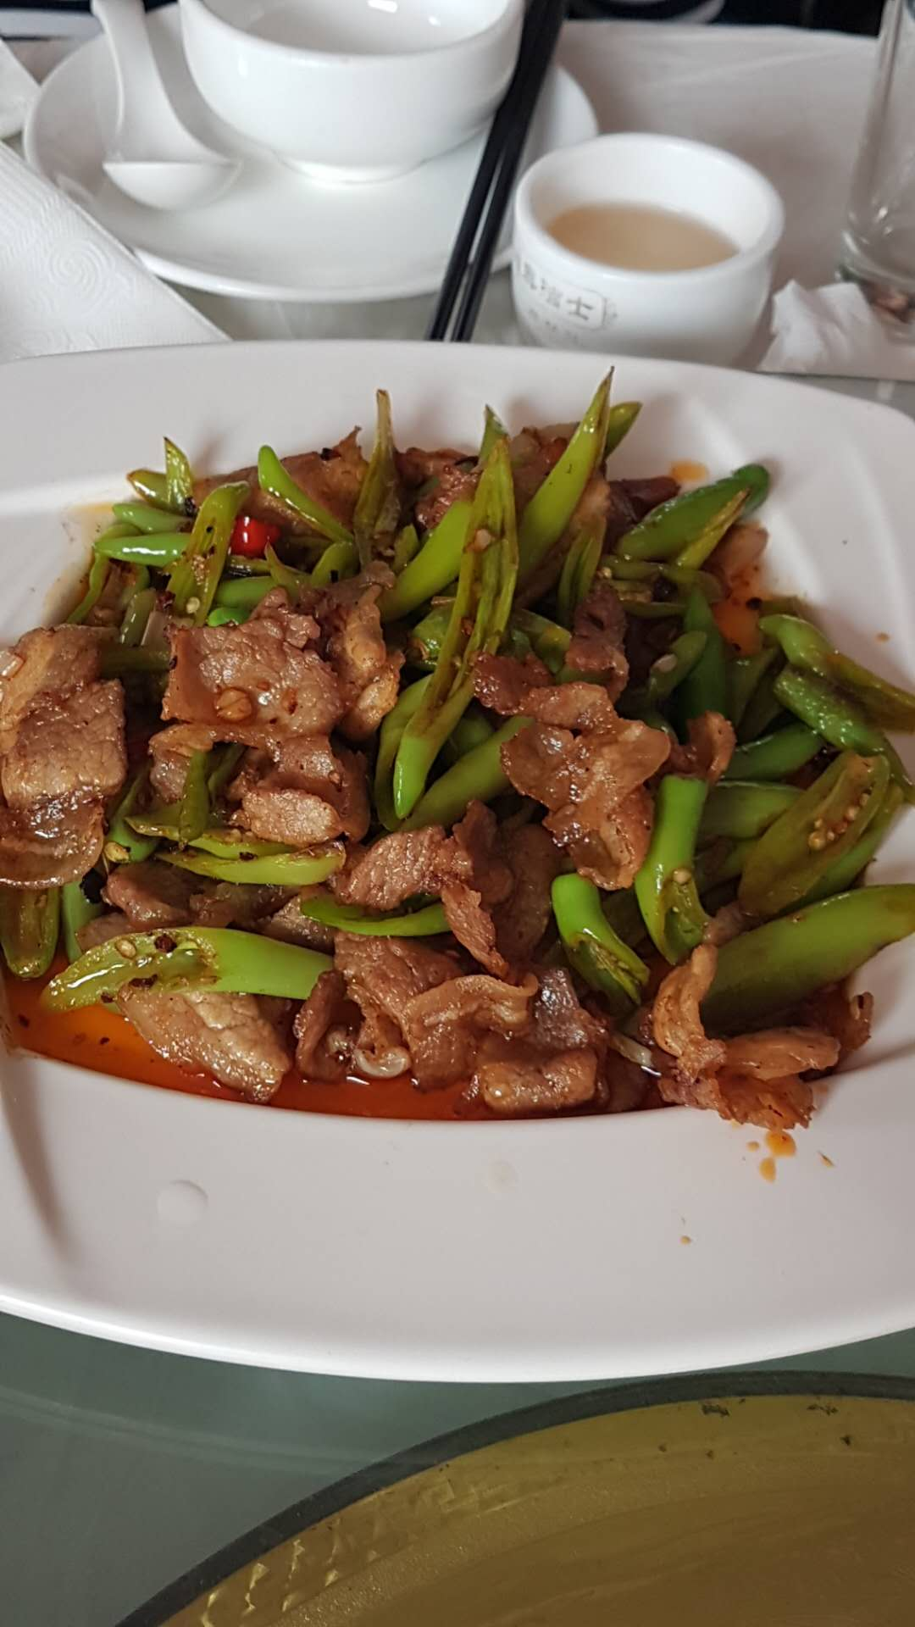
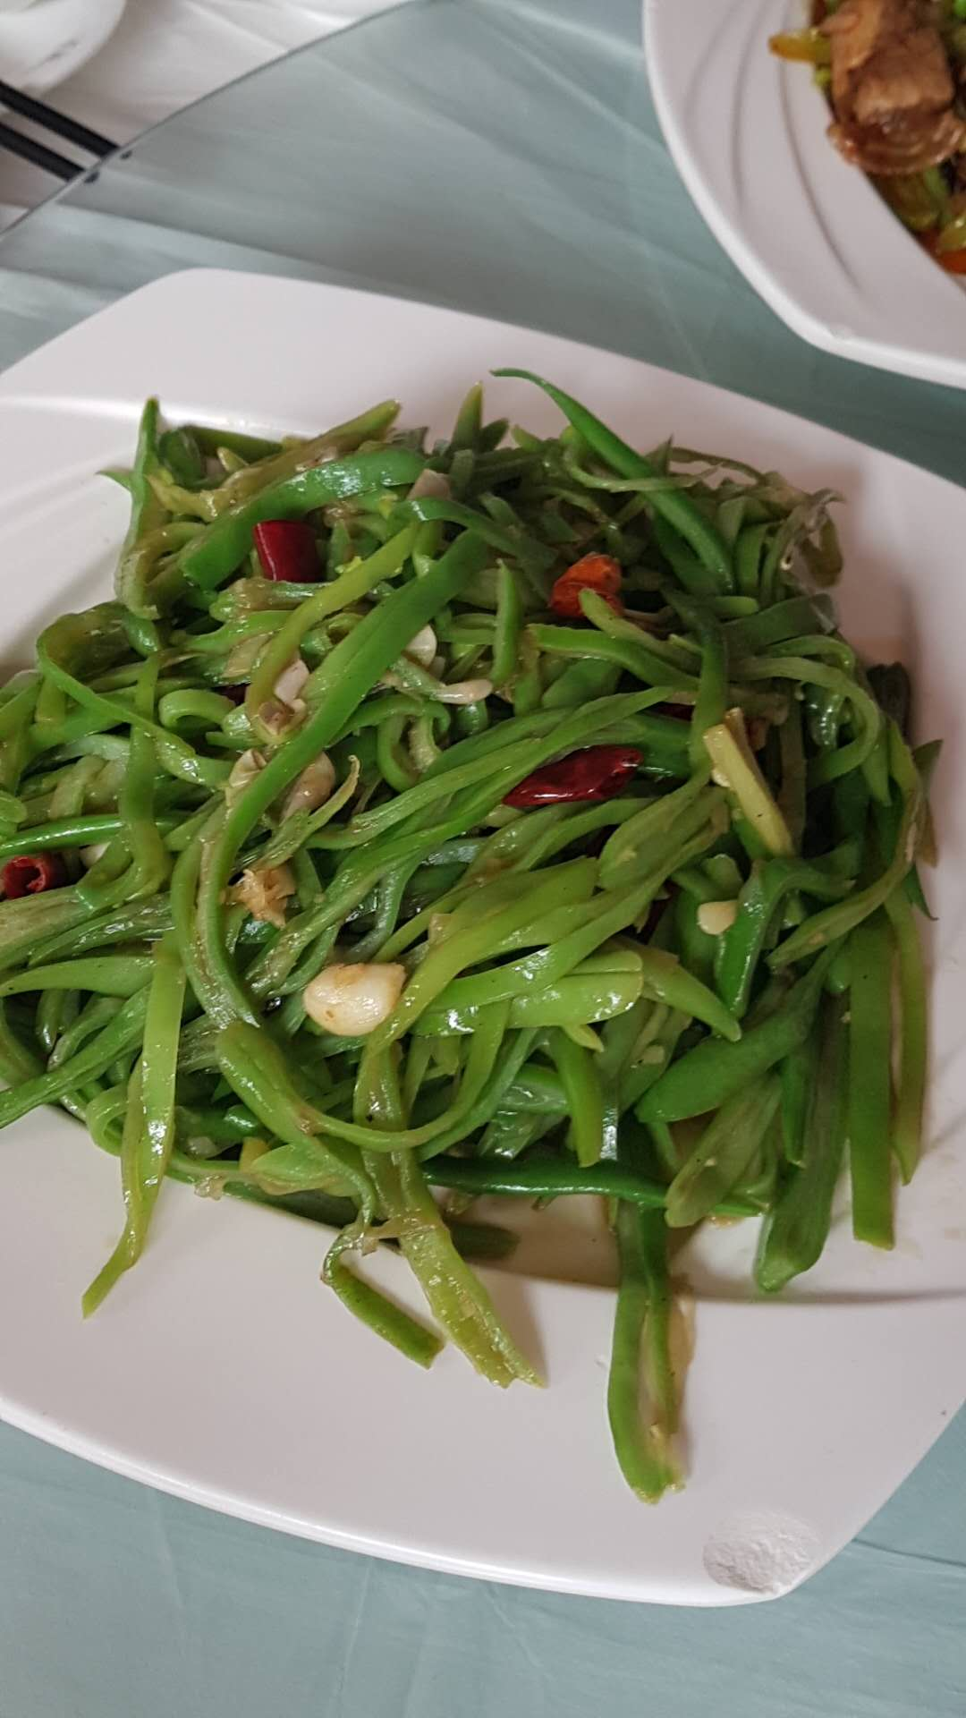
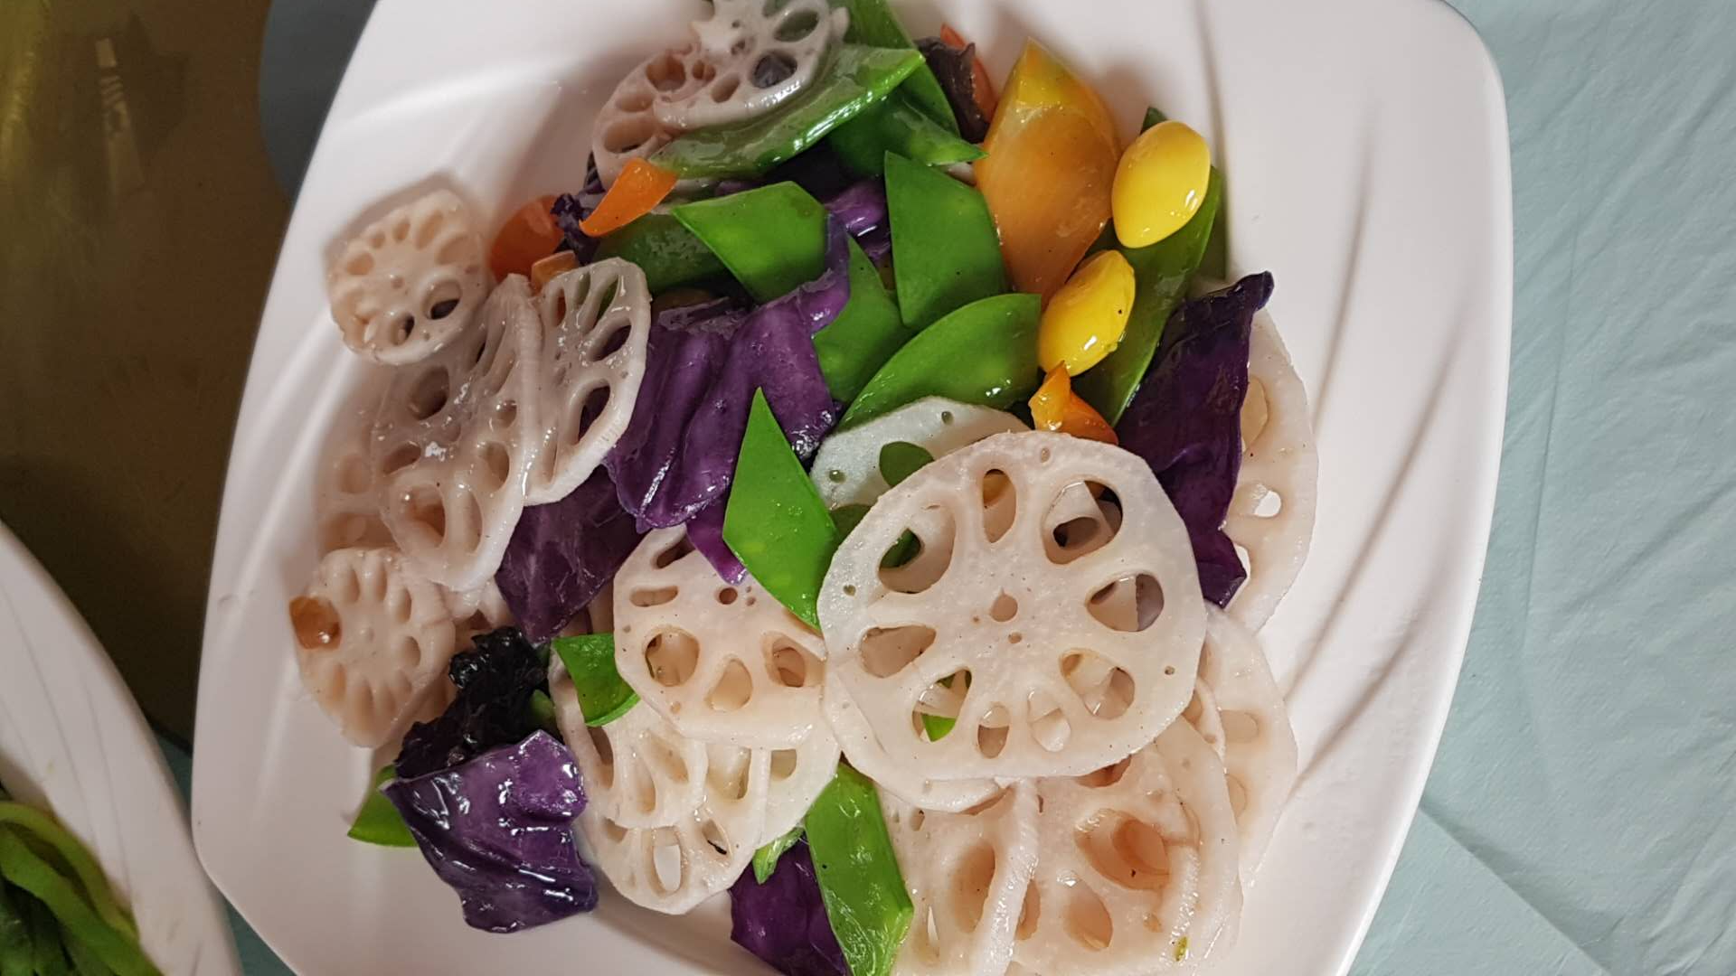
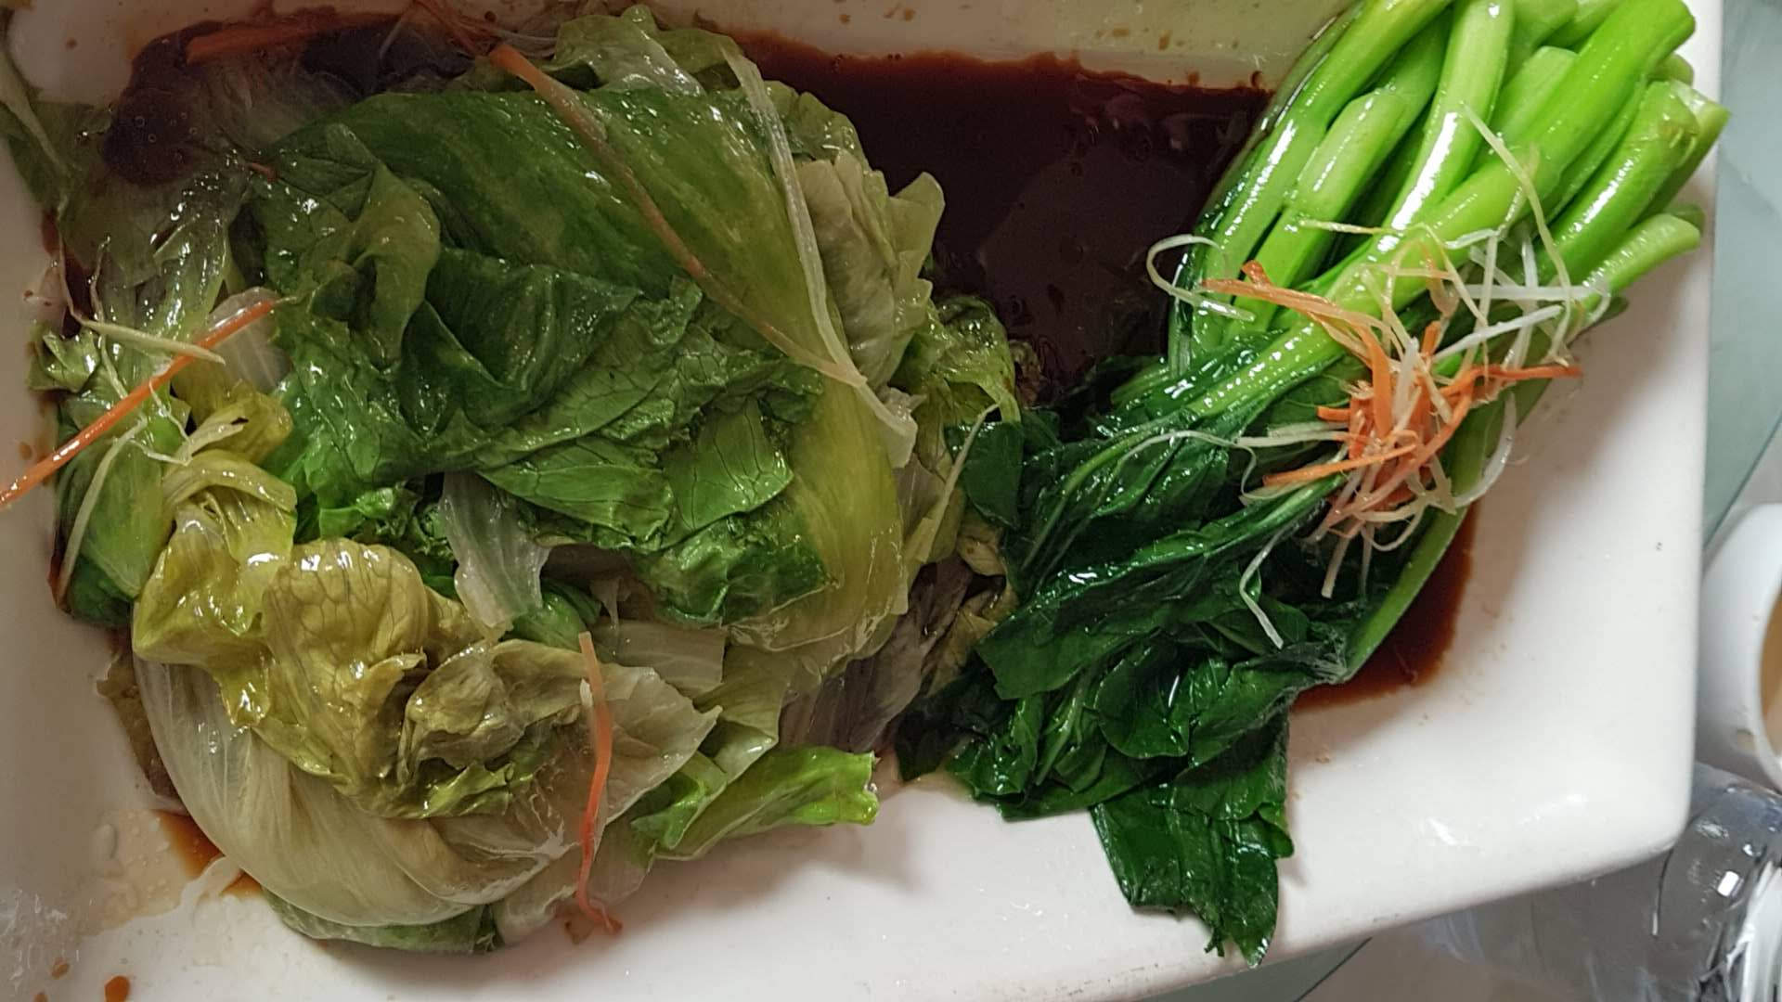

Slide 35
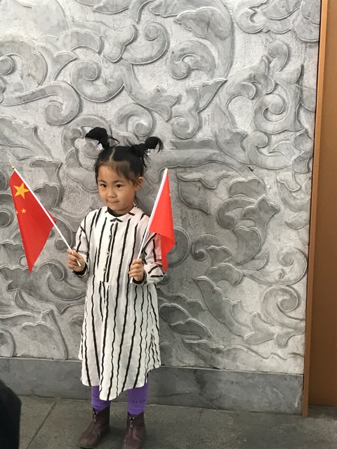
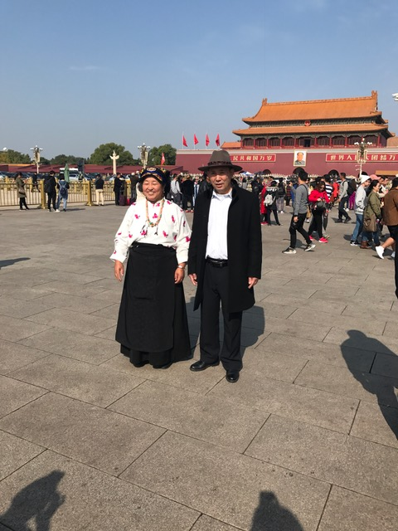
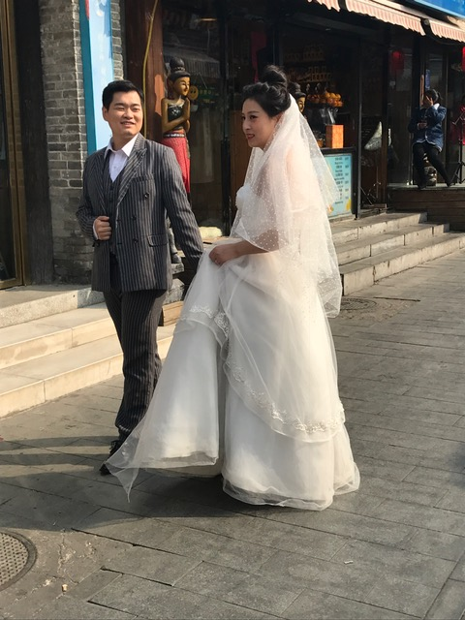
Traditional Dress

Slide 36
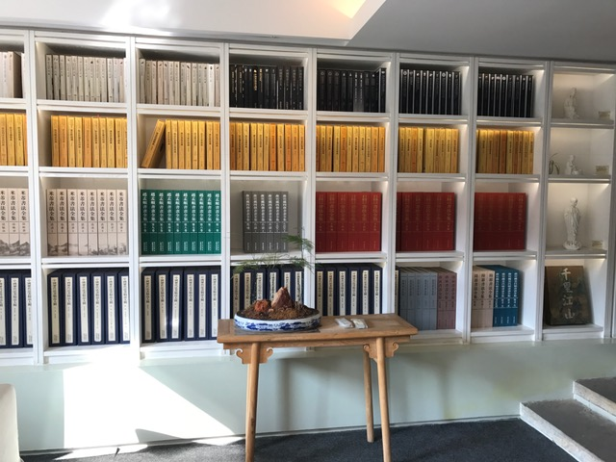
The Forbidden City

Slide 37
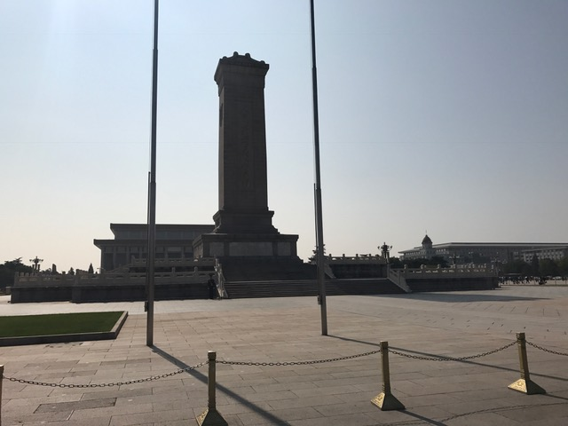
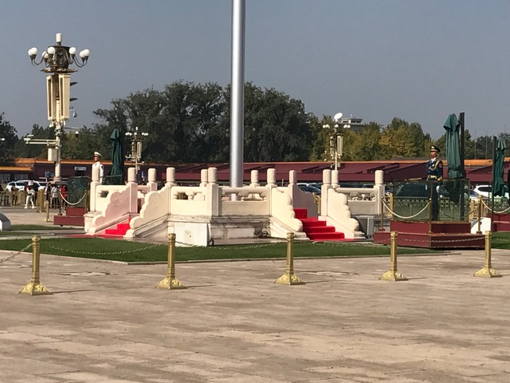
Tian’anmen Square

Slide 38
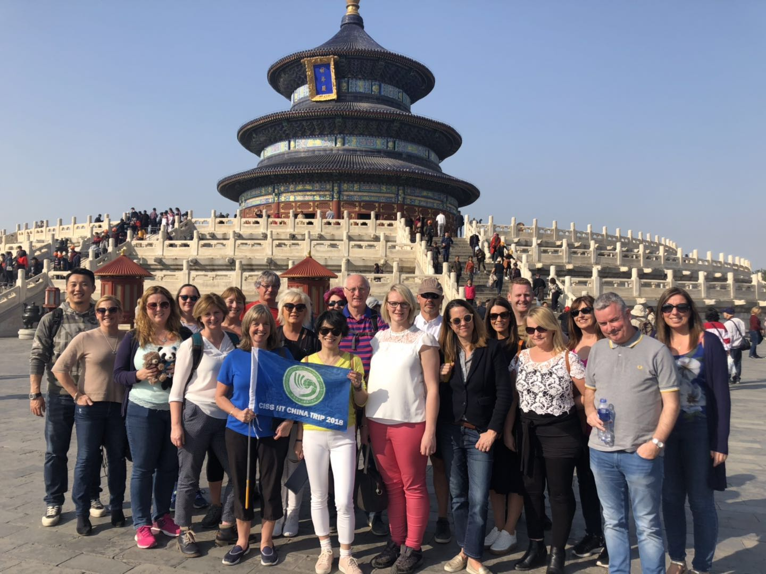
The Temple of Heaven
https://m.youtube.com/watch?v=A7JFl8IL1zI

Slide 39
The Hutongs by Tricycle

Slide 40
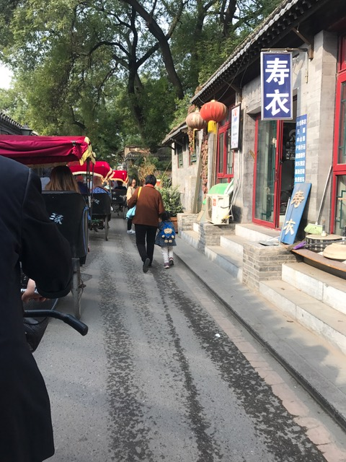
The Hutongs

Slide 41
The Summer Palace
https://m.youtube.com/watch?v=bbsXMaAalew

Slide 42
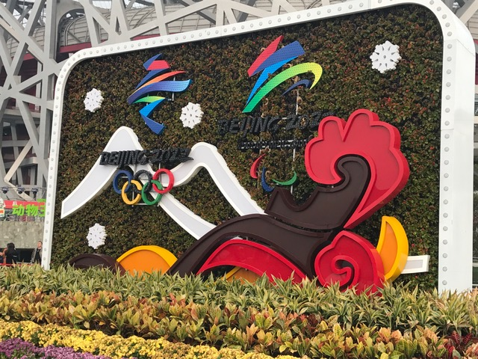
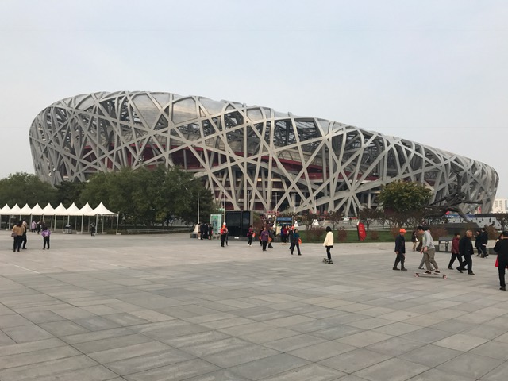
The Birds Nest
https://m.youtube.com/watch?v=E4R5pwuhVJ0

